Slide 1
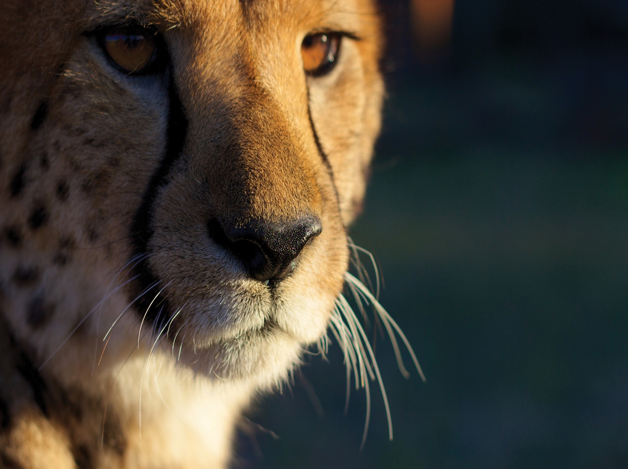

Slide 2
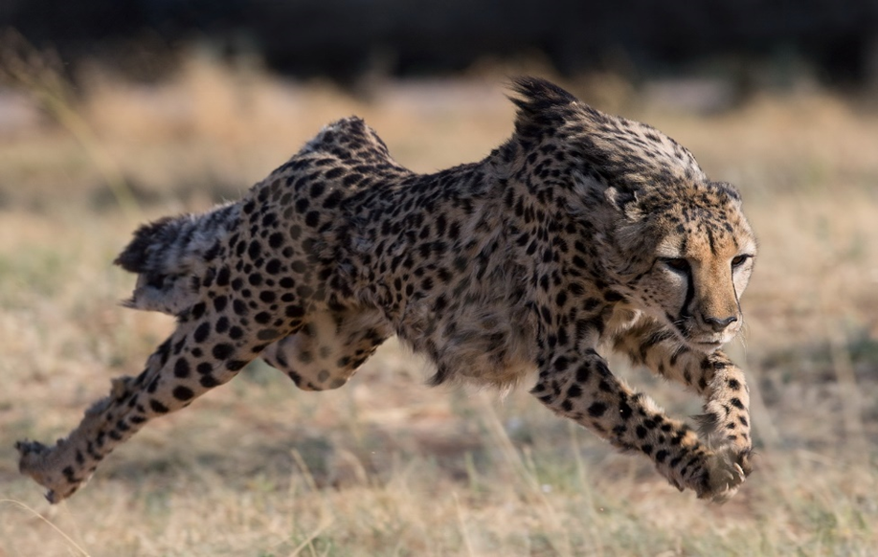

Slide 3
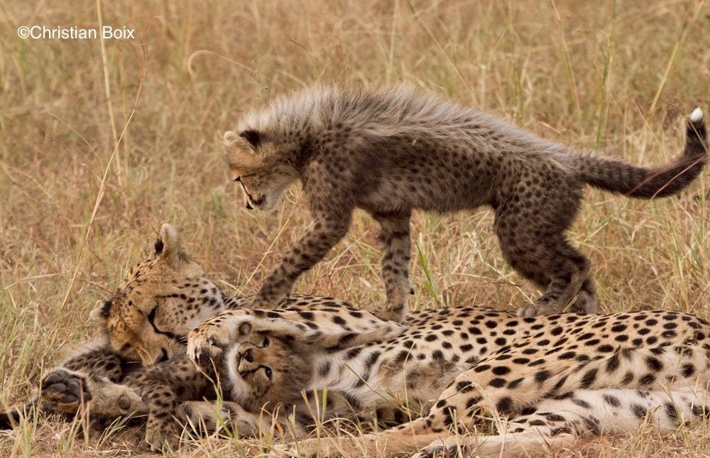
Cheetah Conservation Fund (CCF)
Founded in Namibia in 1990, Cheetah Conservation Fund (CCF) is dedicated to saving the cheetah in the wild
CCF has formal partners in:
Australia, Canada, France, Germany, Italy, United Kingdom, & USA

Slide 4
CCF’s International Scope
CCF has assisted to establish cheetah conservation organizations in:
Kenya, Botswana, South Africa, Iran, Zimbabwe.
CCF consults with colleagues and government agencies in other cheetah range countries including: Zambia, India, Algeria, Ethiopia, Angola, Mozambique, Southern Sudan and Niger.
CCF is a core member of the IUCN Cat Specialist Group, helping develop regional strategies for cheetahs throughout their range.
Contributes to international biomedical databases and maintains a Genome Resource Bank.

Slide 5
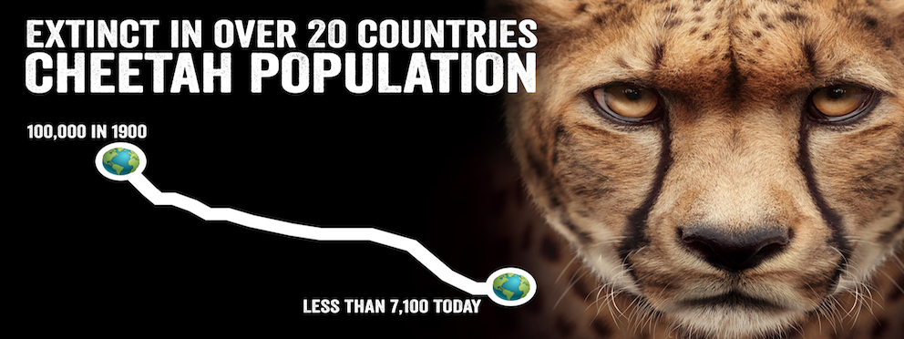
The cheetah is the world’s fastest
land animal and Africa’s most endangered big cat.

Slide 6
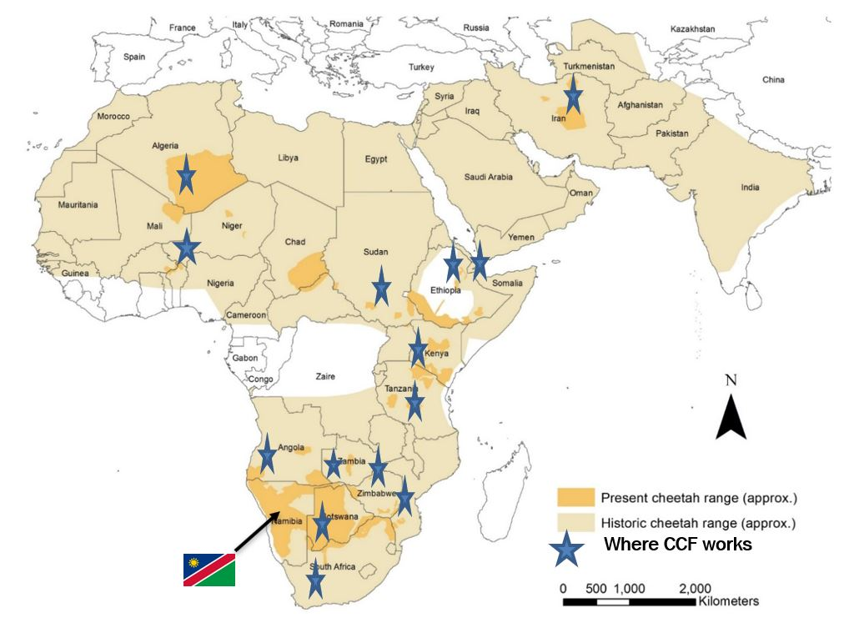
Cheetah Distribution
Only 26% of their former range
< 7,100 adult cheetahs (confirmed range)
31 populations – 23 countries
20 populations are < 100 individuals
77% are outside of protected areas
50% are in southern Africa

Slide 7
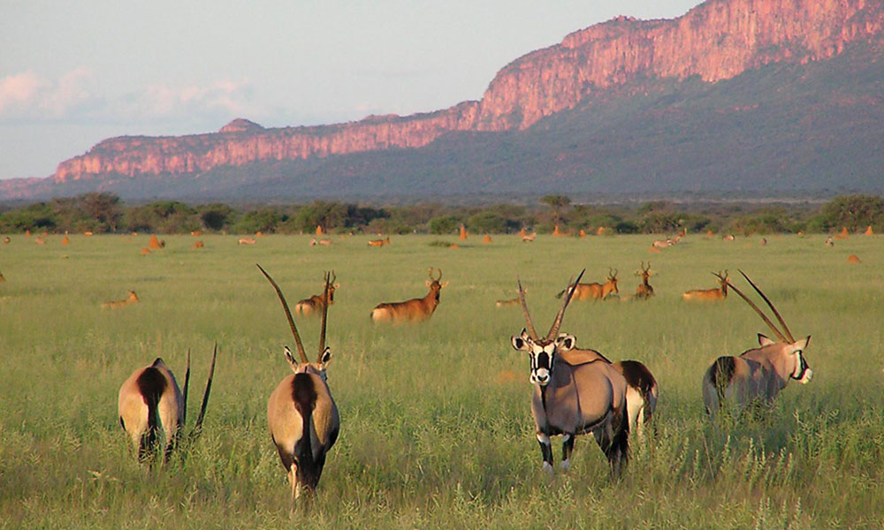
CCF’s location: The Waterberg Conservancy Conservancy)
Notes:
Waterberg Conservancy and Greater Waterberg Landscape-allows for free movement
Talk about where CCF is located and why

Slide 8
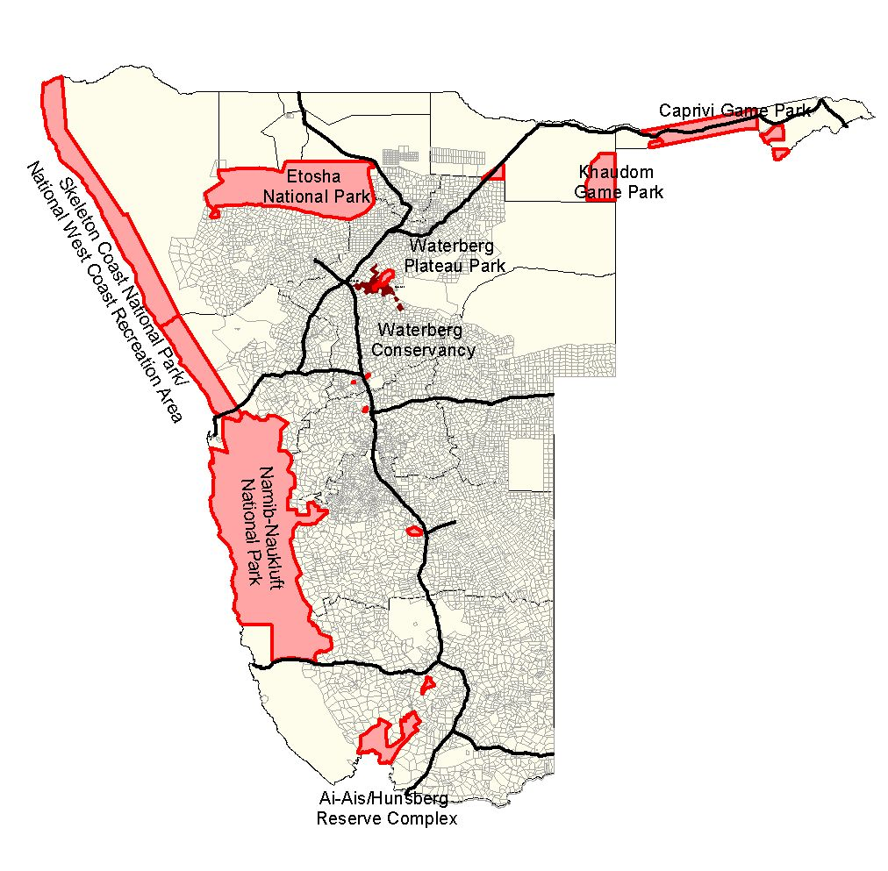
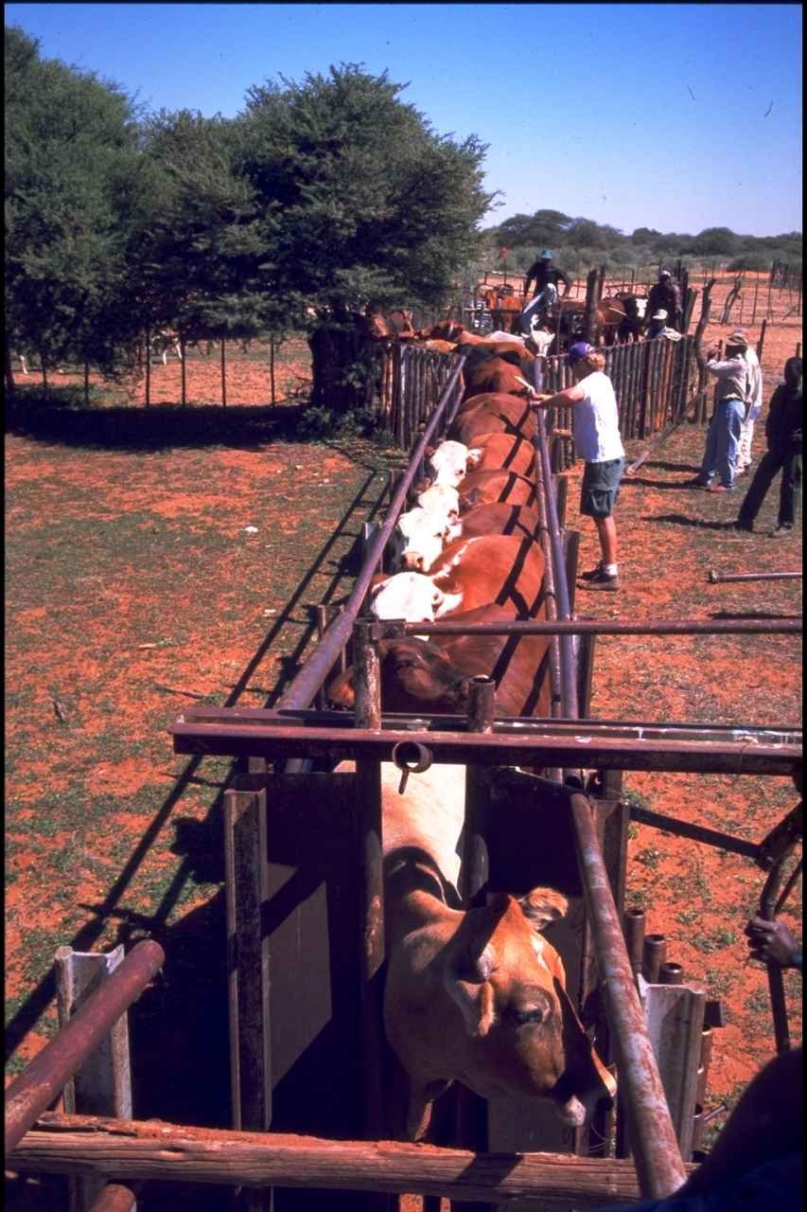
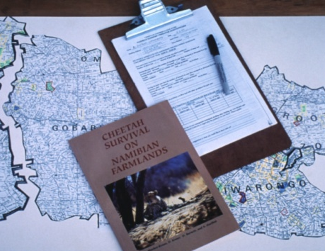
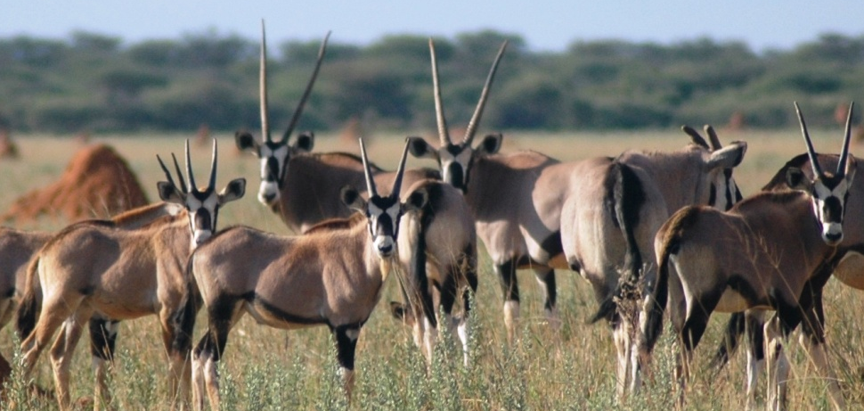
Farming Supports 70% of Namibians
Communal
Commercial
National Park
Cheetah area
Supports 90% of the cheetahs
Notes:
Explain that cheetah live outside national parks

Slide 9
CCF Namibia Research & Education Centre
Notes:
CCF Open to the Public - Field Research Centre
CCF operates a Model Farm to train, test and refine integrated livestock and wildlife management programmes
CCF operates Biomass Demonstration Centre encourage sustainable utilization of the encroaching thornbush and produces BushBlok.
CCF creates employment for ~ 130 people

Slide 10
CCF’s Strategic Programs
Notes:
Talk about some aspects of what CCF does as a whole

Slide 11
Core Programs
Better understanding of the cheetah’s challenges
Education /
HWC mitigation
Alternative livelihoods
Biomedical Research
Genetic Research
Scat Detection Dogs
Ecological Research
Economic evaluation
Re-wilding
Bush harvesting / alternative energy
Model Farm
Dairy
Eco-tourism
Future Farmers Program
International courses
Education outreach
Livestock guarding dogs

Slide 12
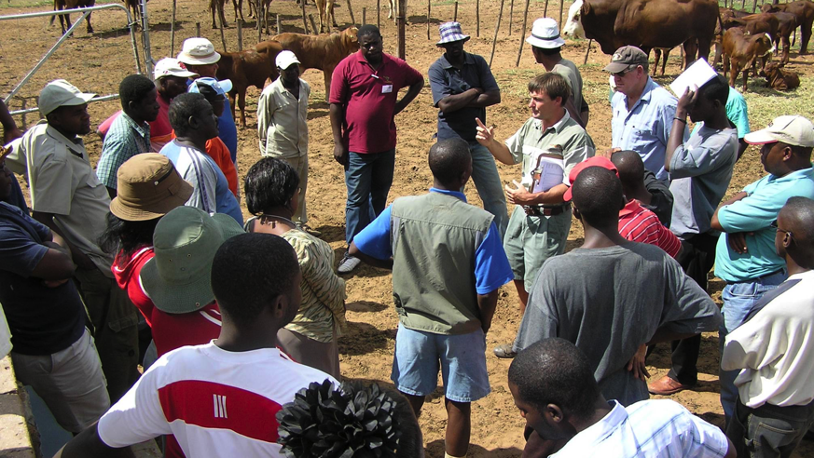
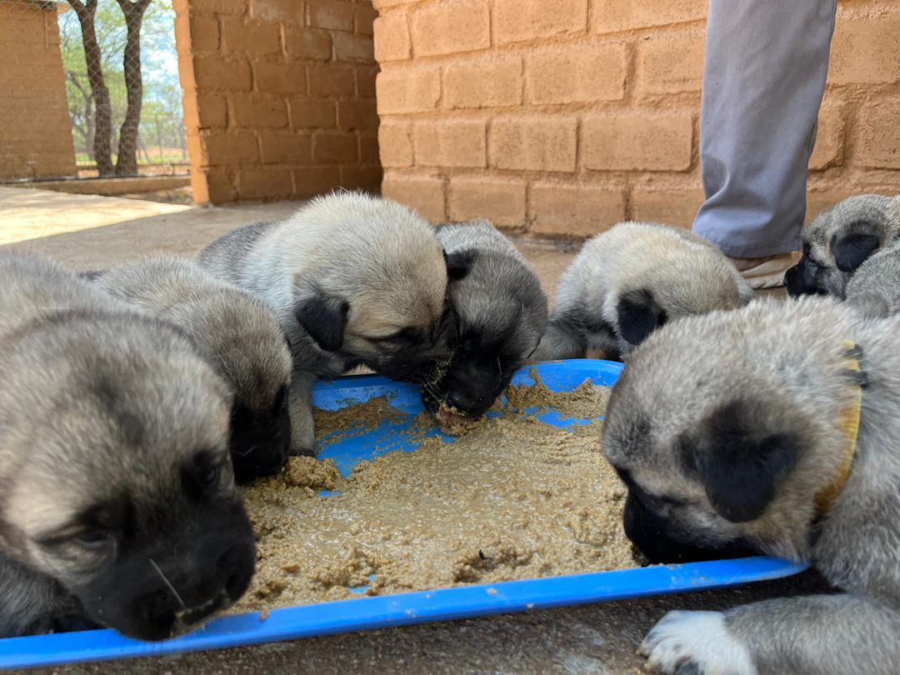
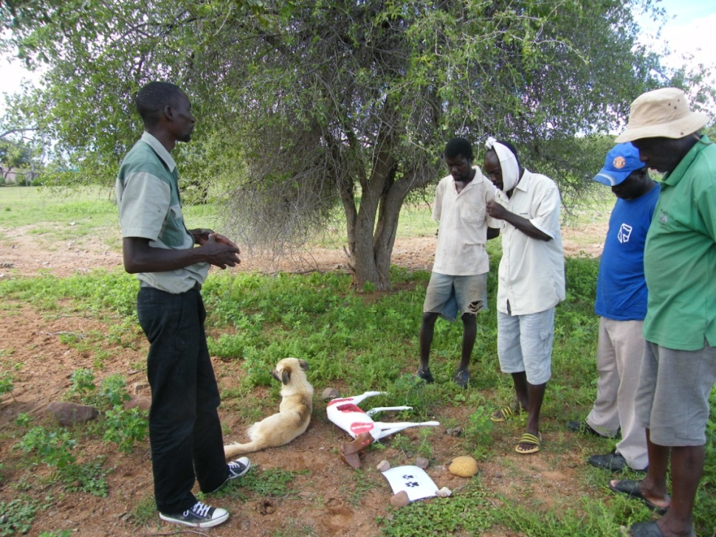
CCF’s Conservation Programs
Dogs saving cats
Since 1994, CCF has placed 700 dogs on farms
Farmer education programs
In 2022, CCF visited 17 villages (HWC areas) and worked with 225 farmers
Notes:
CCF has developed models for mitigating human wildlife conflict, including the use of livestock guarding dogs and farmer’s training.
CCF investigates and applies carnivore census technology including radio-telemetry, camera trapping, and genetic DNA analysis.
CCF shares its findings in both peer reviewed and other publications and lectures internationally.
CCF responds to farmer and MET requests regarding “problem” cheetah or improperly housed captive animals working with LCMAN.

Slide 13
Livestock Guarding Dogs

Slide 14
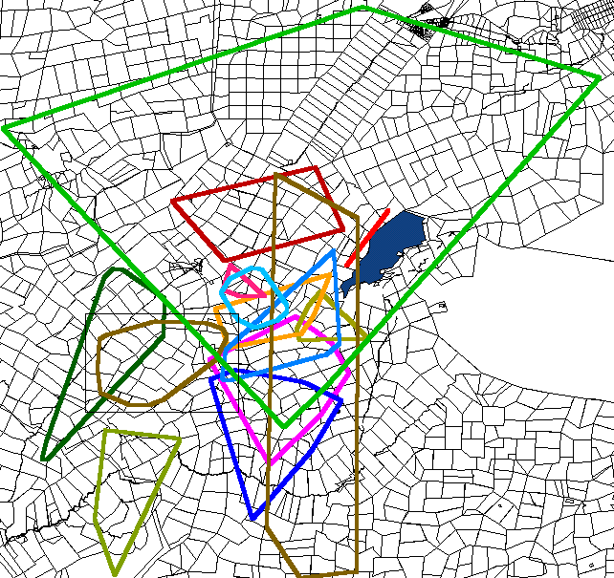
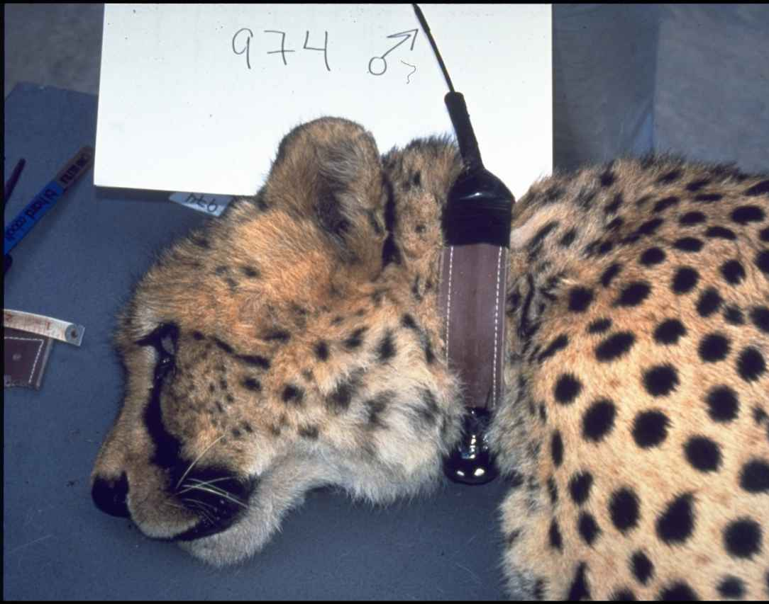
Cheetah Ecology affects human/predator conflict
Home ranges larger than elsewhere >1,650km²
~ 20 farms (5,000ha each)
Greater overlap with related animals.
Need large scale conservation plans that provide economic value for allowing cheetahs on their lands.
95% Minimum Convex Polygon
<650 released back to the wild

Slide 15
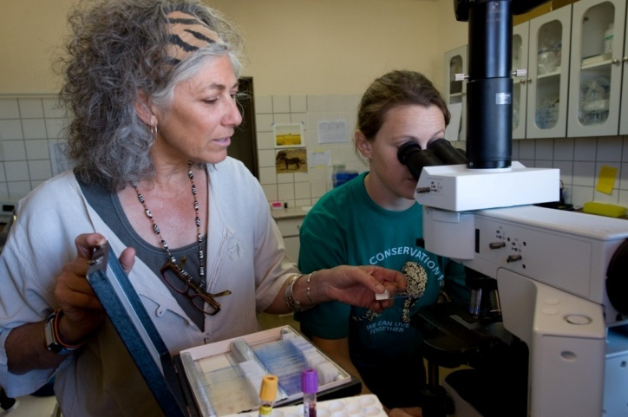
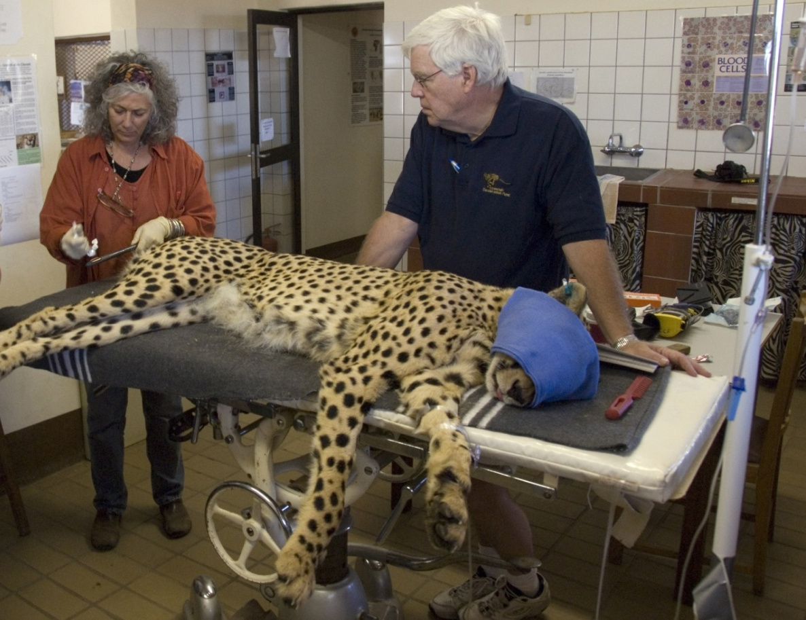
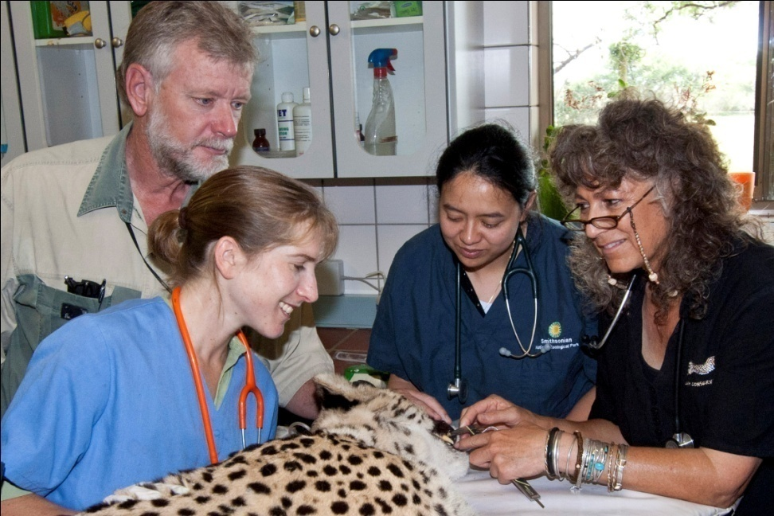
Understanding Cheetah Biology & Ecology
Long-term health studies – over 900 individuals
Notes:
Give brief info on why genetics and reproduction are important. Sum up at end importance of these – by understanding biology of Namibian cheetahs, can best understand the threats facing them and how to manage them.

Slide 16
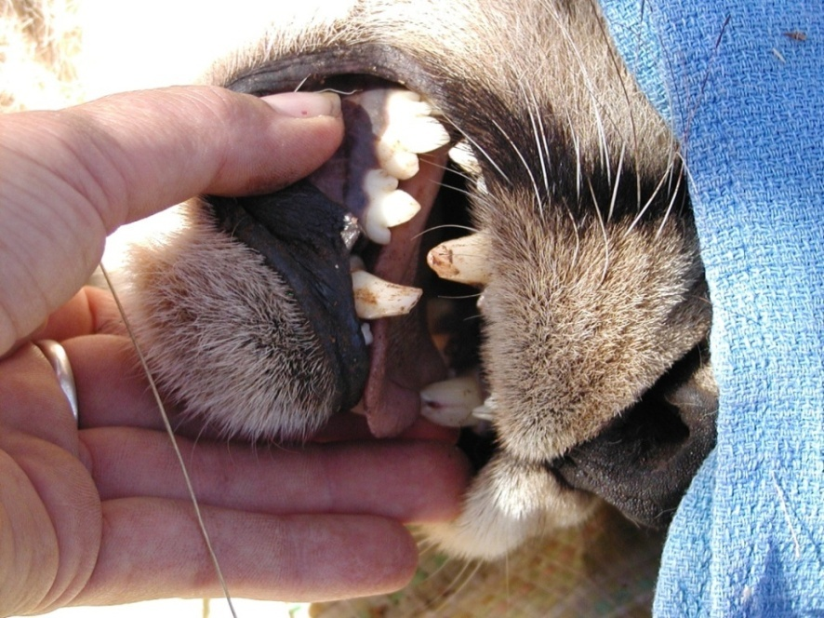
Reasons for live capture of cheetahs

Slide 17
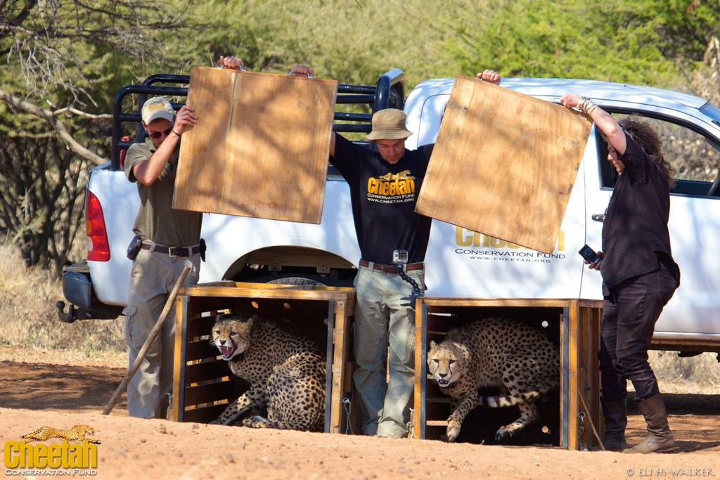

Slide 18
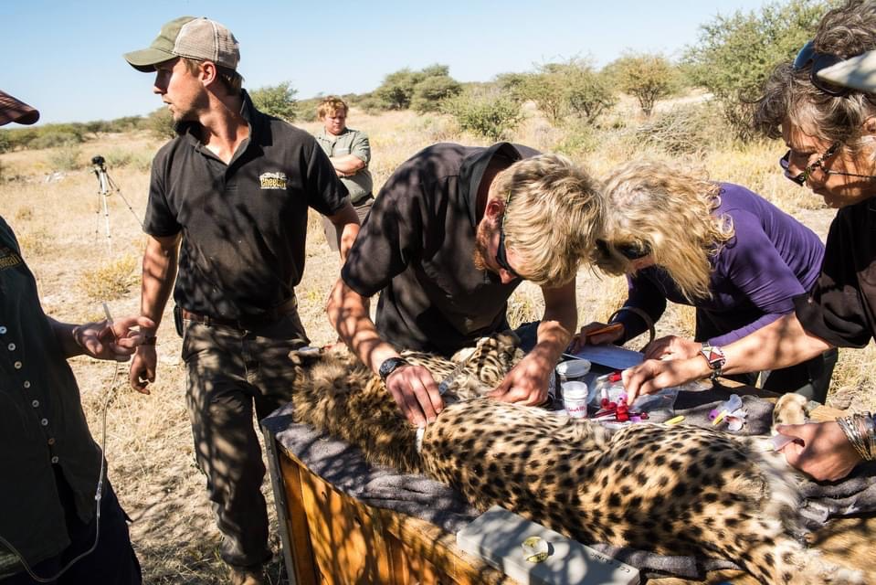

Slide 19
Education is the key
Notes:
CCF emphasizes education and conducts programmes at CCF Centre and at schools throughout the country (> 20,000 students per yr).
CCF conducts farmer and conservancy training.
CCF conducts international training courses in Conservation Biology and Human Wildlife Conflict.
CCF hosts NUST and UNAM interns and international university students

Slide 20
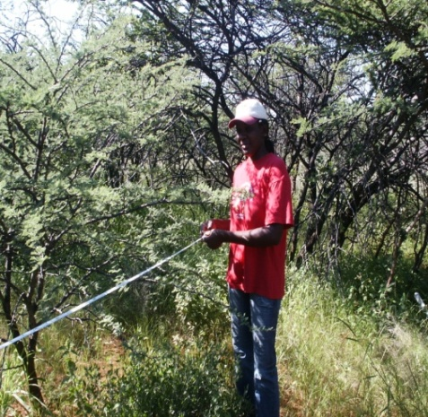
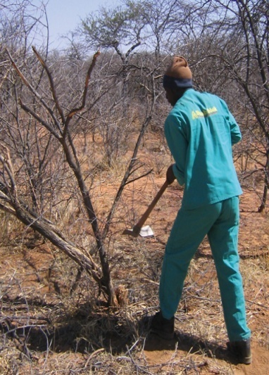
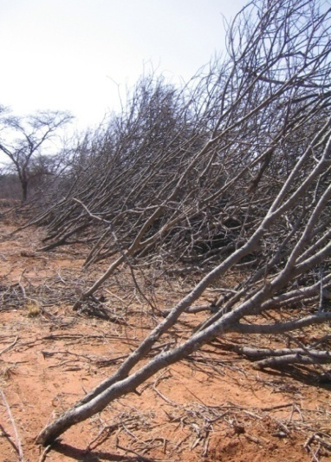
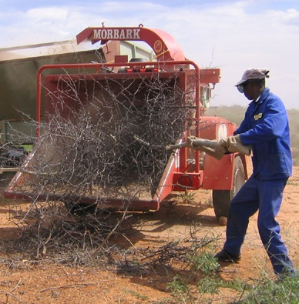
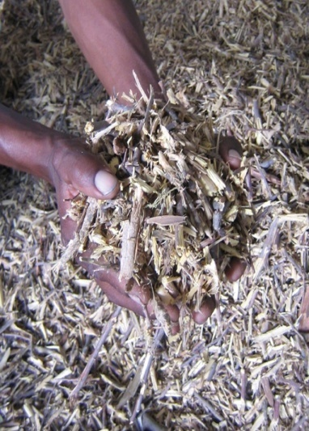
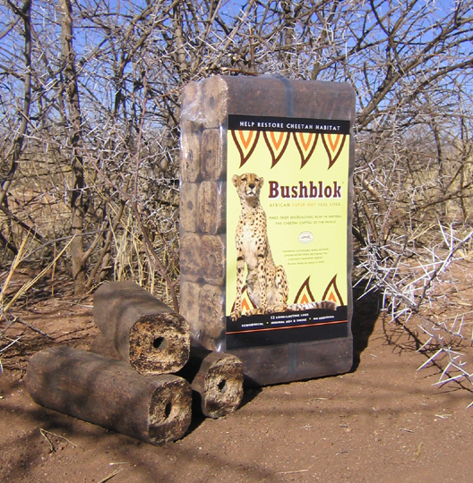
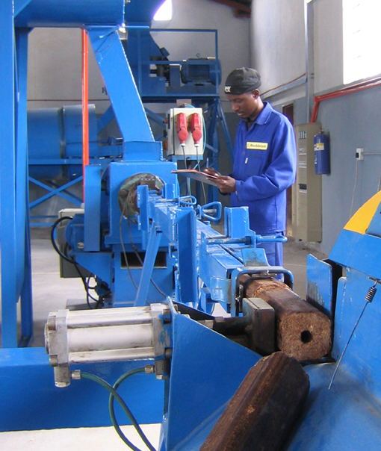
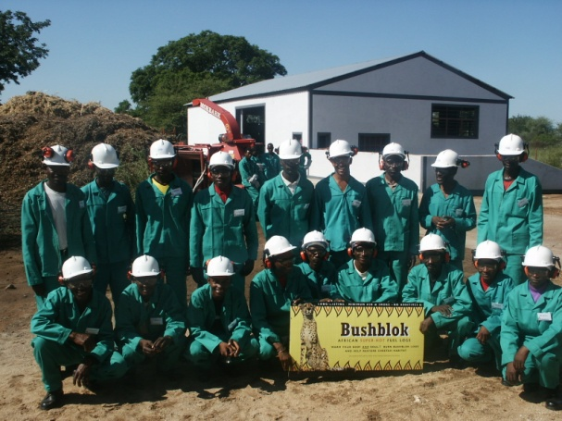
CCF’s Habitat Restoration Program
ECOLOGICAL
How can we restore
Habitat?
ECONOMIC
How can we pay for
habitat restoration?
SOCIAL
How can the local
community derive
benefits from
natural resources?
Notes:
Looked for appropriate intervention.

Slide 21
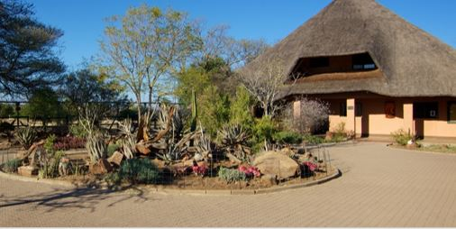
Successes
Rescue/Rehab:
*Health studies have been completed on
*>1200 individual animals
*>70 animals have been rehabilitated by CCF
*>600 animals were captured and released
Human-Wildlife Conflict:
*>750 Livestock Guarding Dogs (LGDs) have been
placed in Namibia and other parts of Africa
and over 175 of them are currently working on farms
Education:
*>750,000 Namibian students have visited CCF
+ many international schools
*>45,000 farmers trained
*>3500 domestic dogs rabies vaccinated
Notes:
Read numbers and talk a little about the projects importance

Slide 22
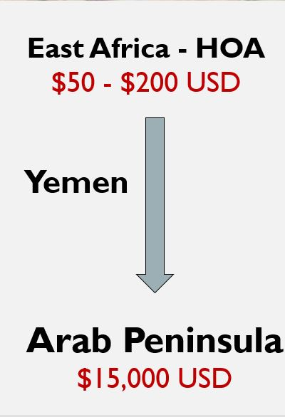
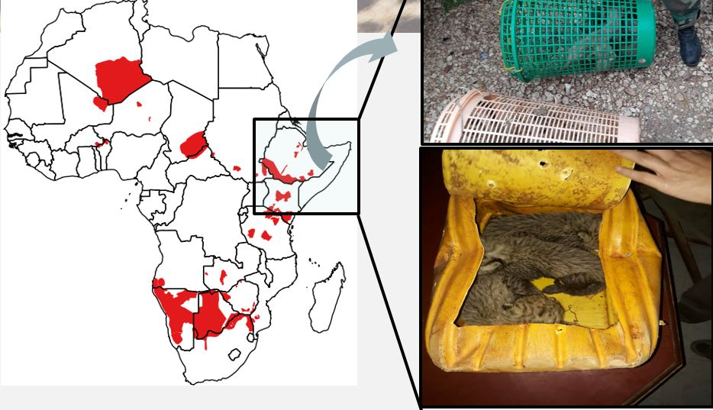
Illegal Wildlife Trade: A Huge ThreatHuge Threat
200-300 animals/year removed from the wild to fuel the IWT
Notes:
Intro to the Illegal wildlife trade in cheetahs-why it is so profitable for those doing it and why it needs to stop

Slide 23
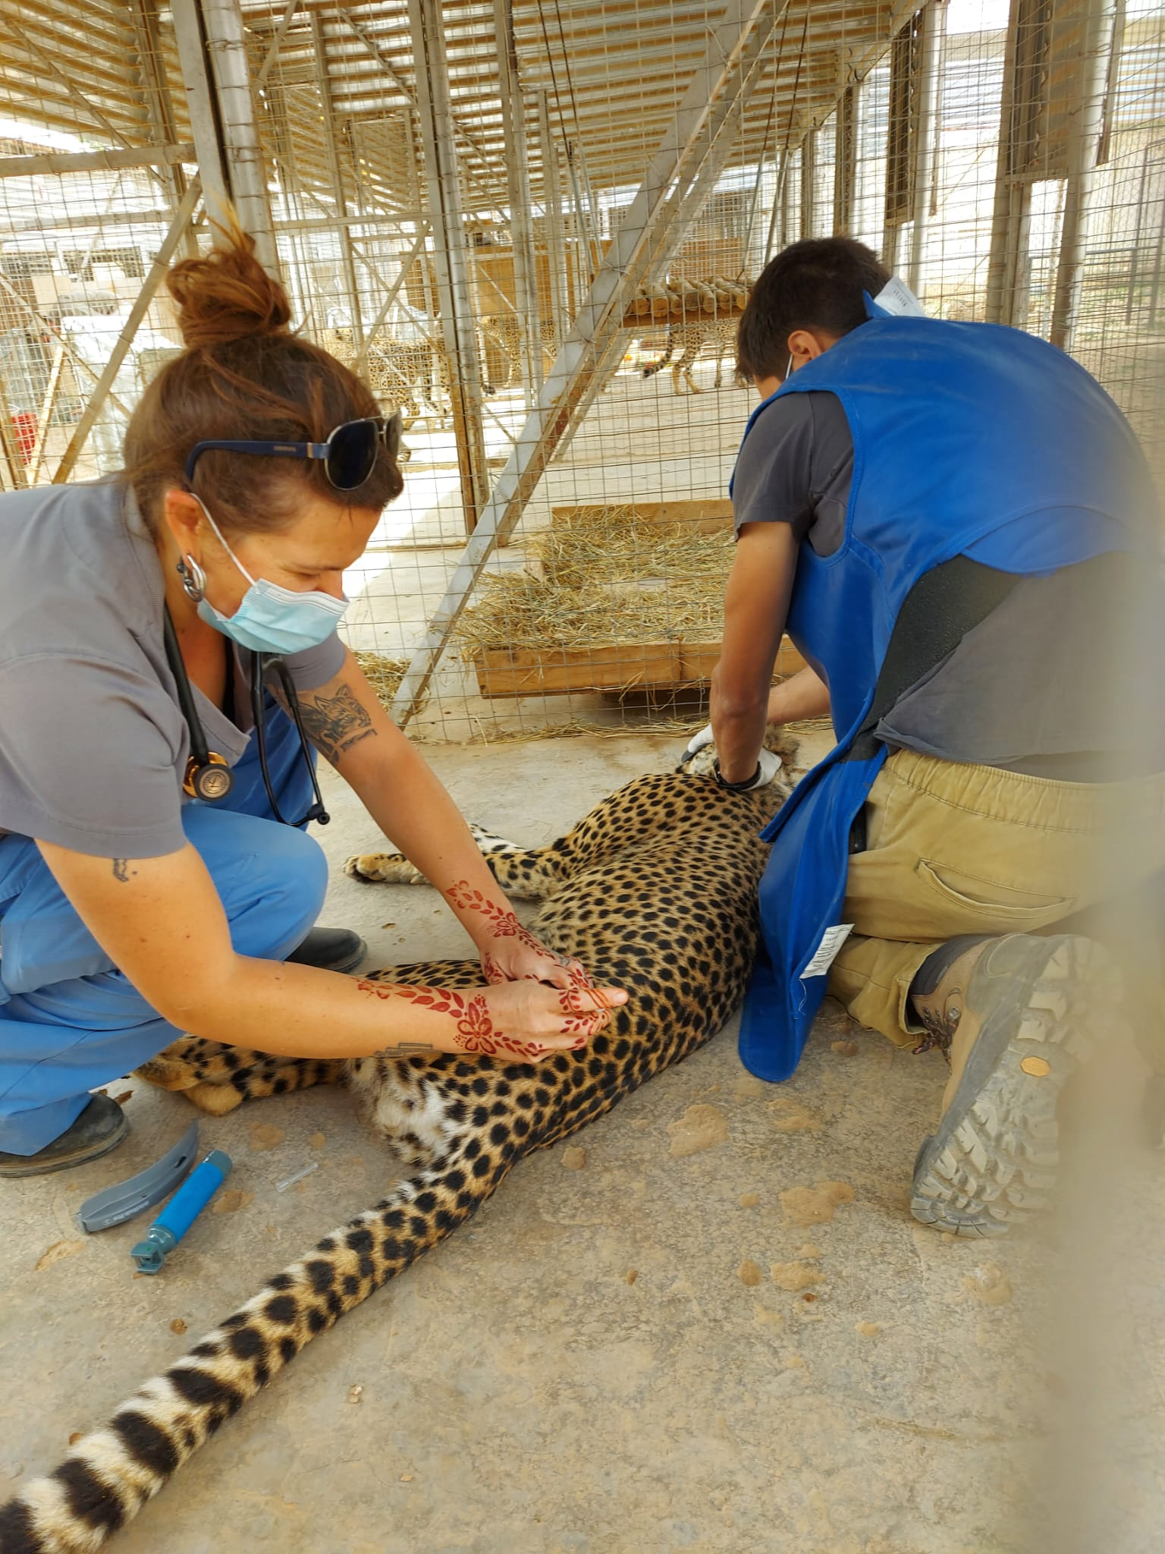
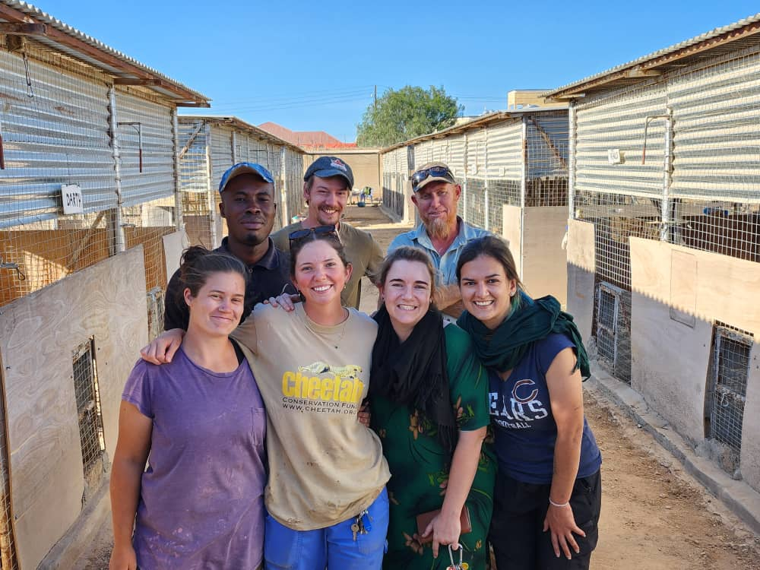
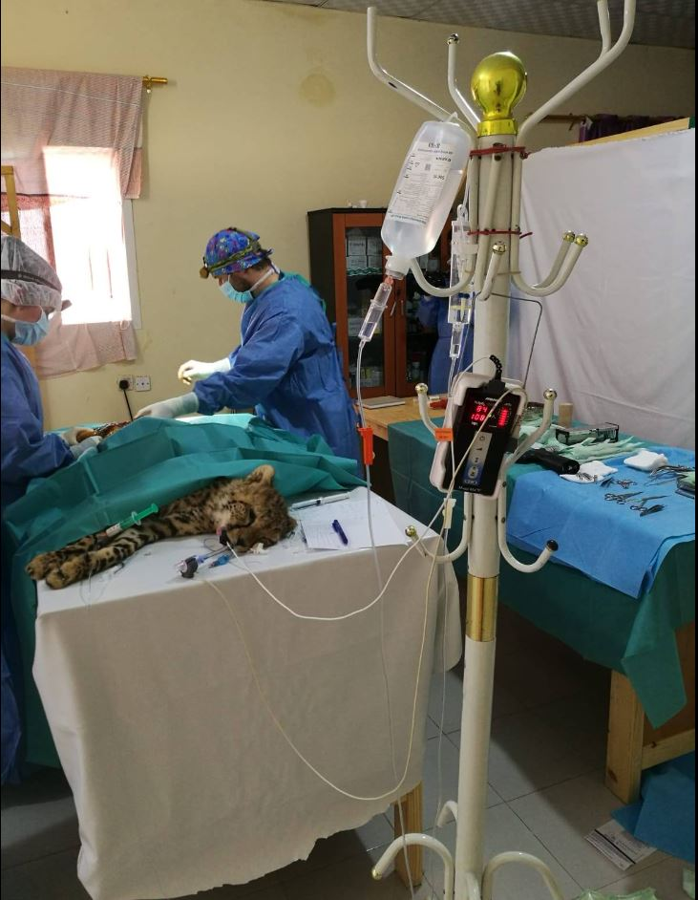
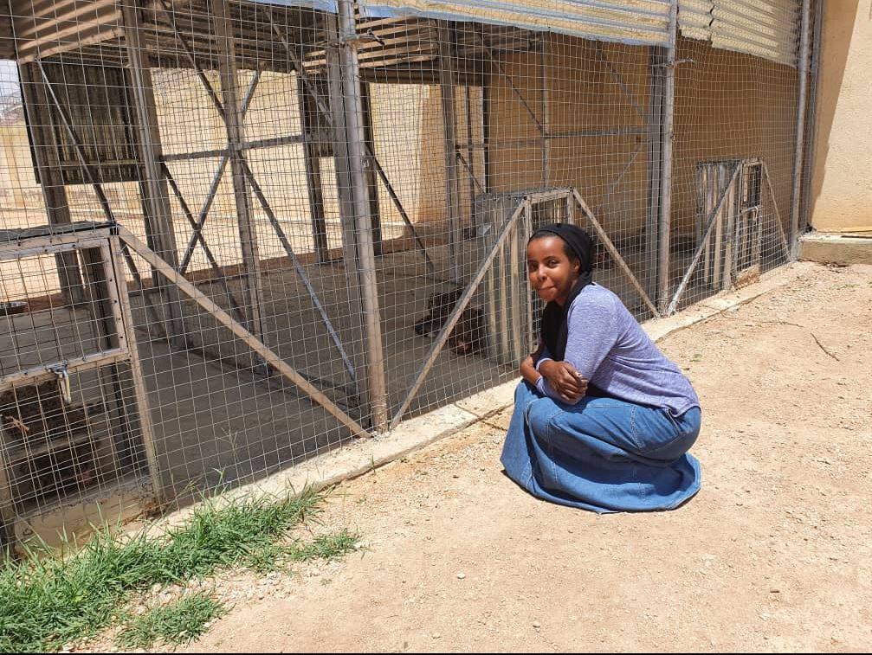
CCF Facilities in Somaliland Hargeisa
Safe Houses x3 in Hargeisa
-1 for cubs (Quarantine)
-2 for older animals
-fully enclosed compounds
-Education/Training Center
-Vet Clinic
-Staff/Volunteer House + Office
***ONLY 1 SAFE HOUSE REMAINS!
Notes:
Talk about where we started and how we kept the Hargeisa facility operational for 4 years+

Slide 24
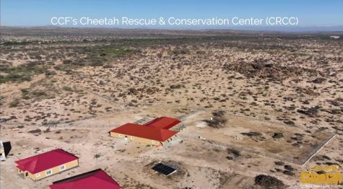
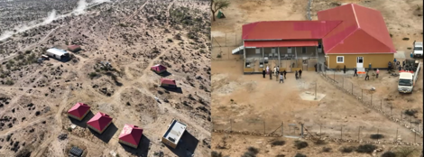
CCF Cheetah Rescued & Conservation Centre
Geed-Deeble

Slide 25
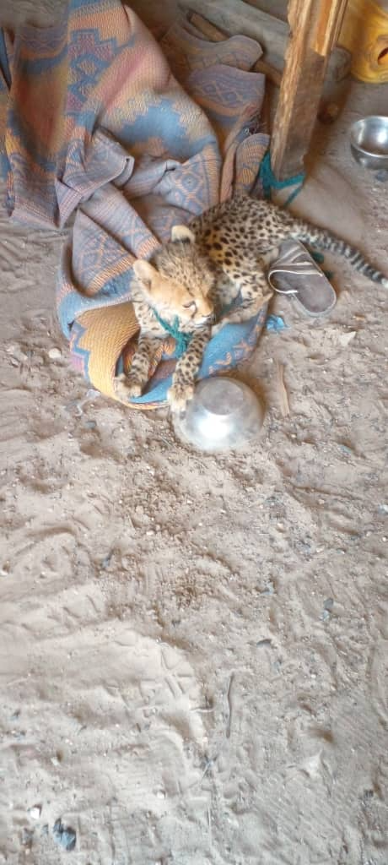
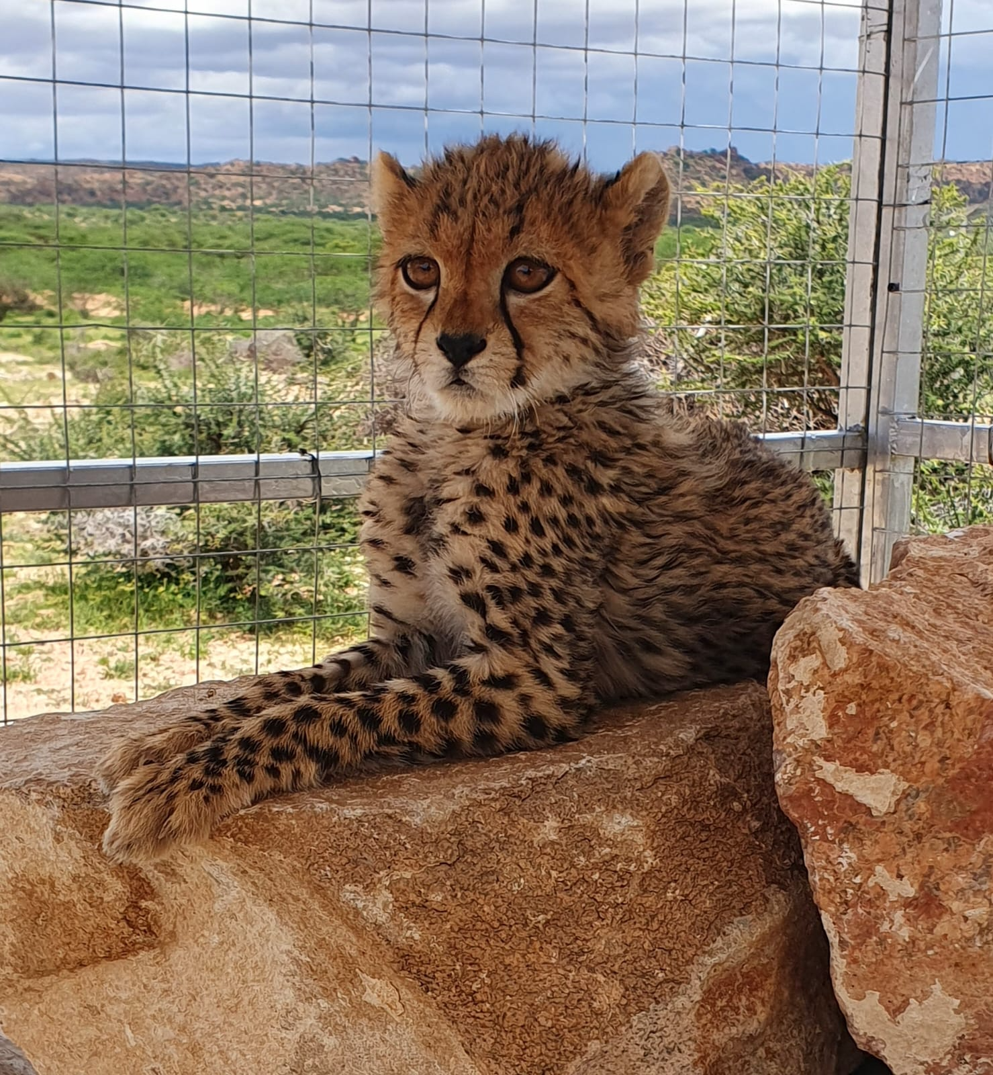
“Lily”
from Rescue to Thriving

Slide 26
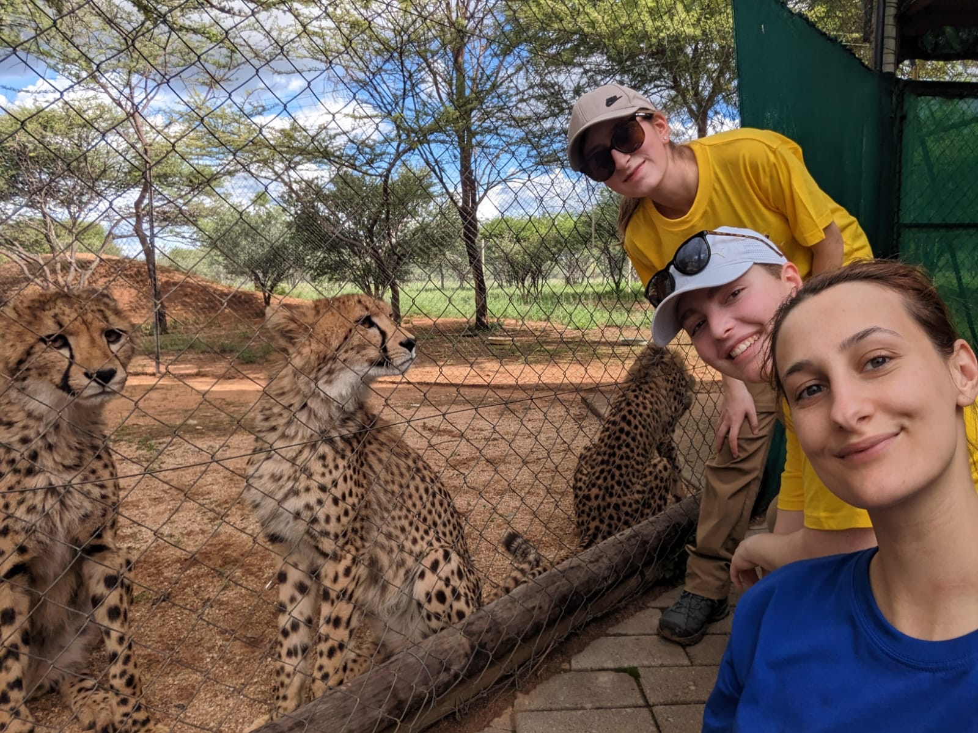
Vanier College (QC) Student Internship Program

Slide 27
Thank You
www.cheetah.org/Canada A. Brewer, PhD
Canada@cheetah.org
Follow us on

